Slide 1


Hunting for Exoplanets with AI
HZ-FIRST EXOPLANET TRIAGE
Rebooters2

Slide 2

Rebooters2
Goal:
Group Members:
Automatically identify exoplanets and highlight Habitable Zone (HZ) cases
Mohammed Redha Abdulla (mohaabdulla)
Nawraa Sayed (nsayed)
Anwar Alghanem (aalghanem)
Ali Alqassab (alii_alqassab)
Abdelrahman Ahmed (abdeahmed)
Hussain Ali (hussain_hht)
Stack:
Python, scikit-learn, optional LightGBM/XGBoost, Flask front-end (HTML/CSS), joblib
Data:
NASA Kepler/K2/TESS catalogs (open datasets)

Slide 3

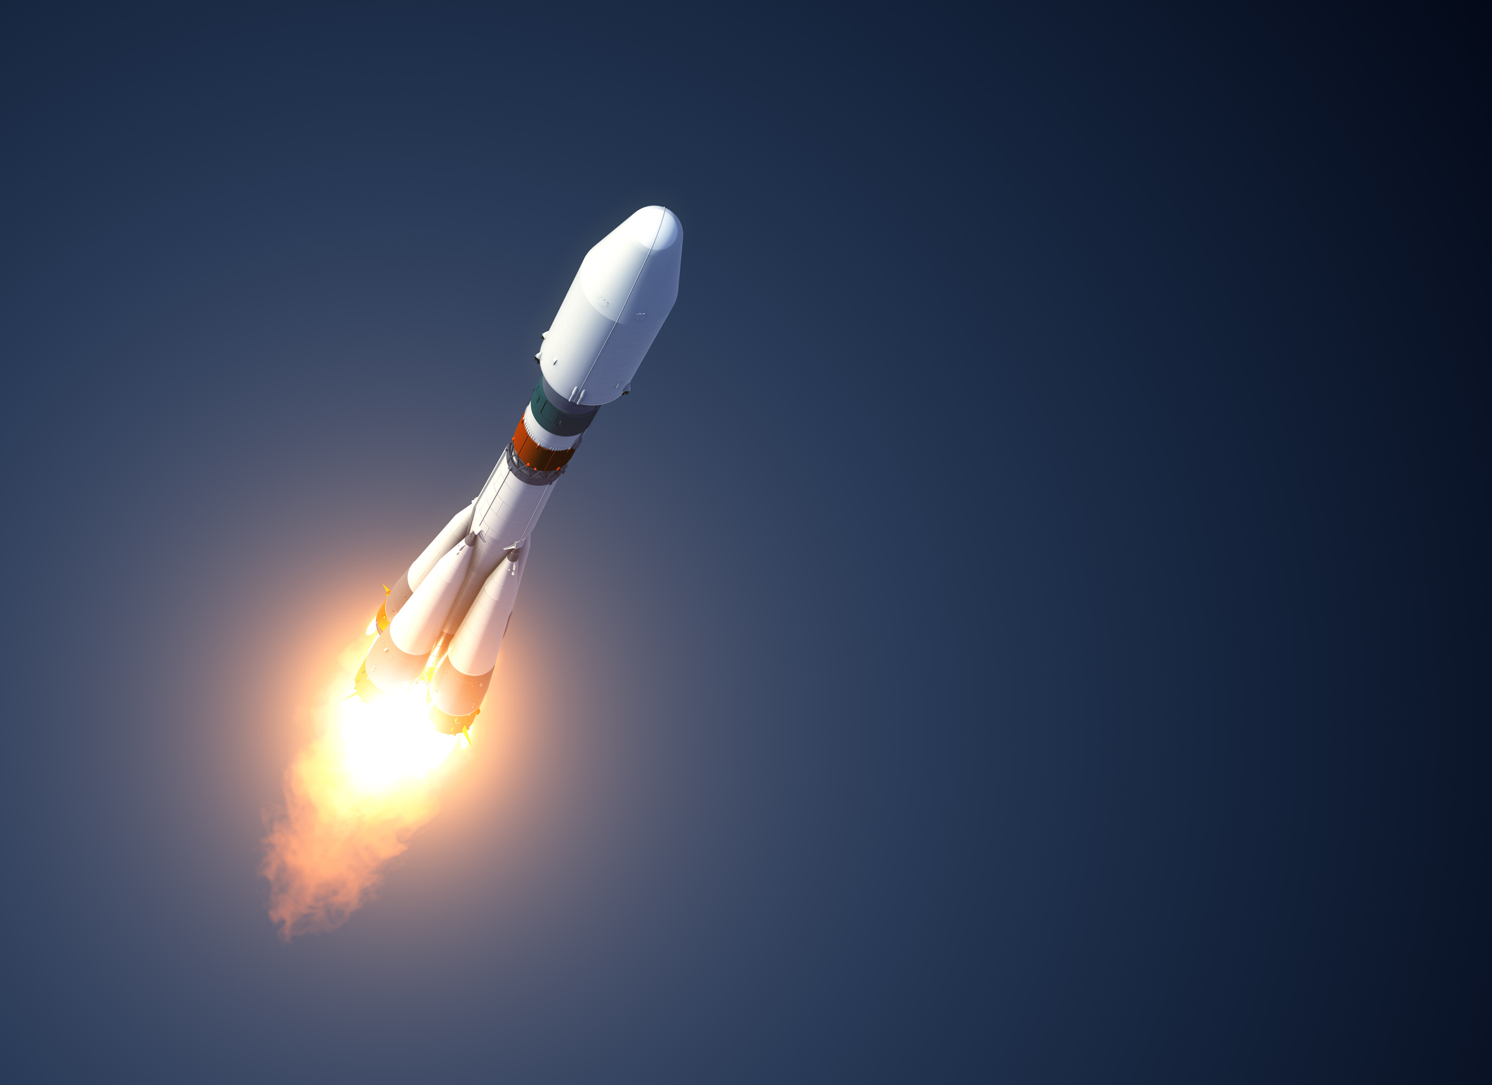
Manual Vetting Slows Exoplanet Discovery
Manual vetting of transit catalogs is slow, inconsistent, and hard to reproduce
Researchers need fast, traceable triage to prioritize promising targets
Our pipeline automatically scores candidates and surfaces likely Habitable Zone (HZ) planets first
Impact: Cuts follow-up time and increases HZ discovery yield

Slide 4
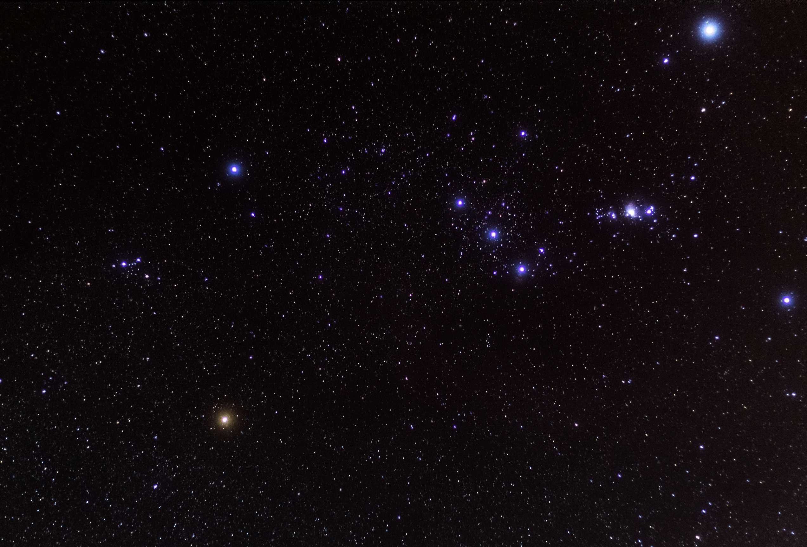

🪐 Data Pipeline & Feature Design
1
Inputs & Cleaning
orbital period, depth, duration, radius, stellar parameters → cleaned with median imputation, scaling, and safe columns only.
2
Feature Engineering
log transforms, normalized depths, ratios, and duration/period features to capture physical patterns
3
HZ Labeling & Split
Habitable Zone (HZ) flag from stellar luminosity (L ∝ R⋆² T⋆⁴); stratified split by class + HZ to preserve rare positives

Slide 5
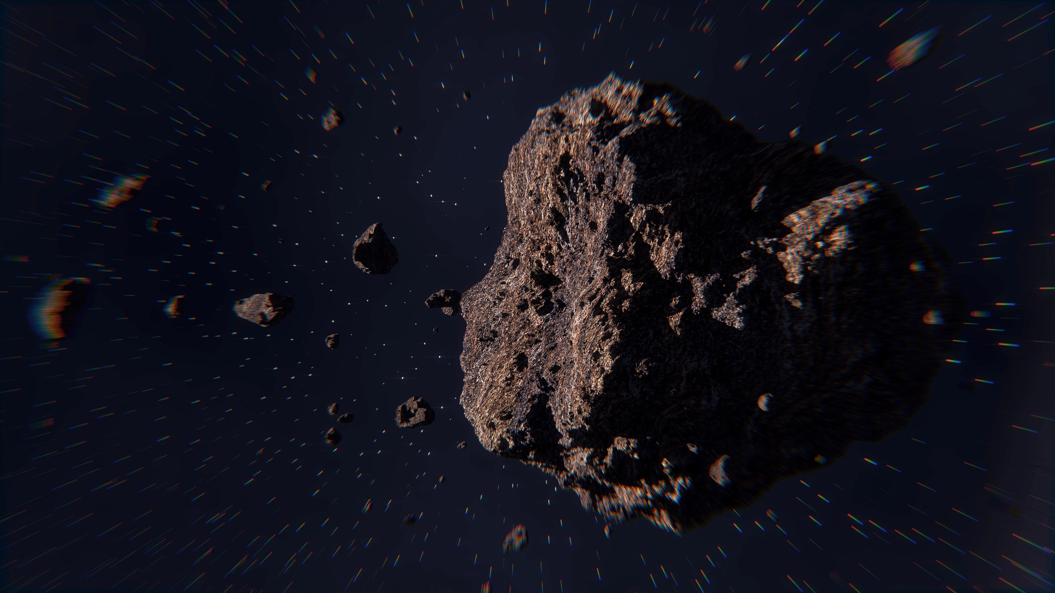
⚙️ Modeling Pipeline & Tuning Strategy
Core Models
HistGradientBoosting and RandomForest (optionally LightGBM/XGBoost) with an IsolationForest filter to protect rare HZ positives
Balancing & Validation
SMOTE (optional) and HZ-weighted sampling; Monte-Carlo cross-validation (60 runs) with PR-AUC and F1 for model selection
Threshold & Calibration
dual thresholds ensure 100% HZ recall on validation; optional isotonic calibration and soft-voting ensemble for stability

Slide 6
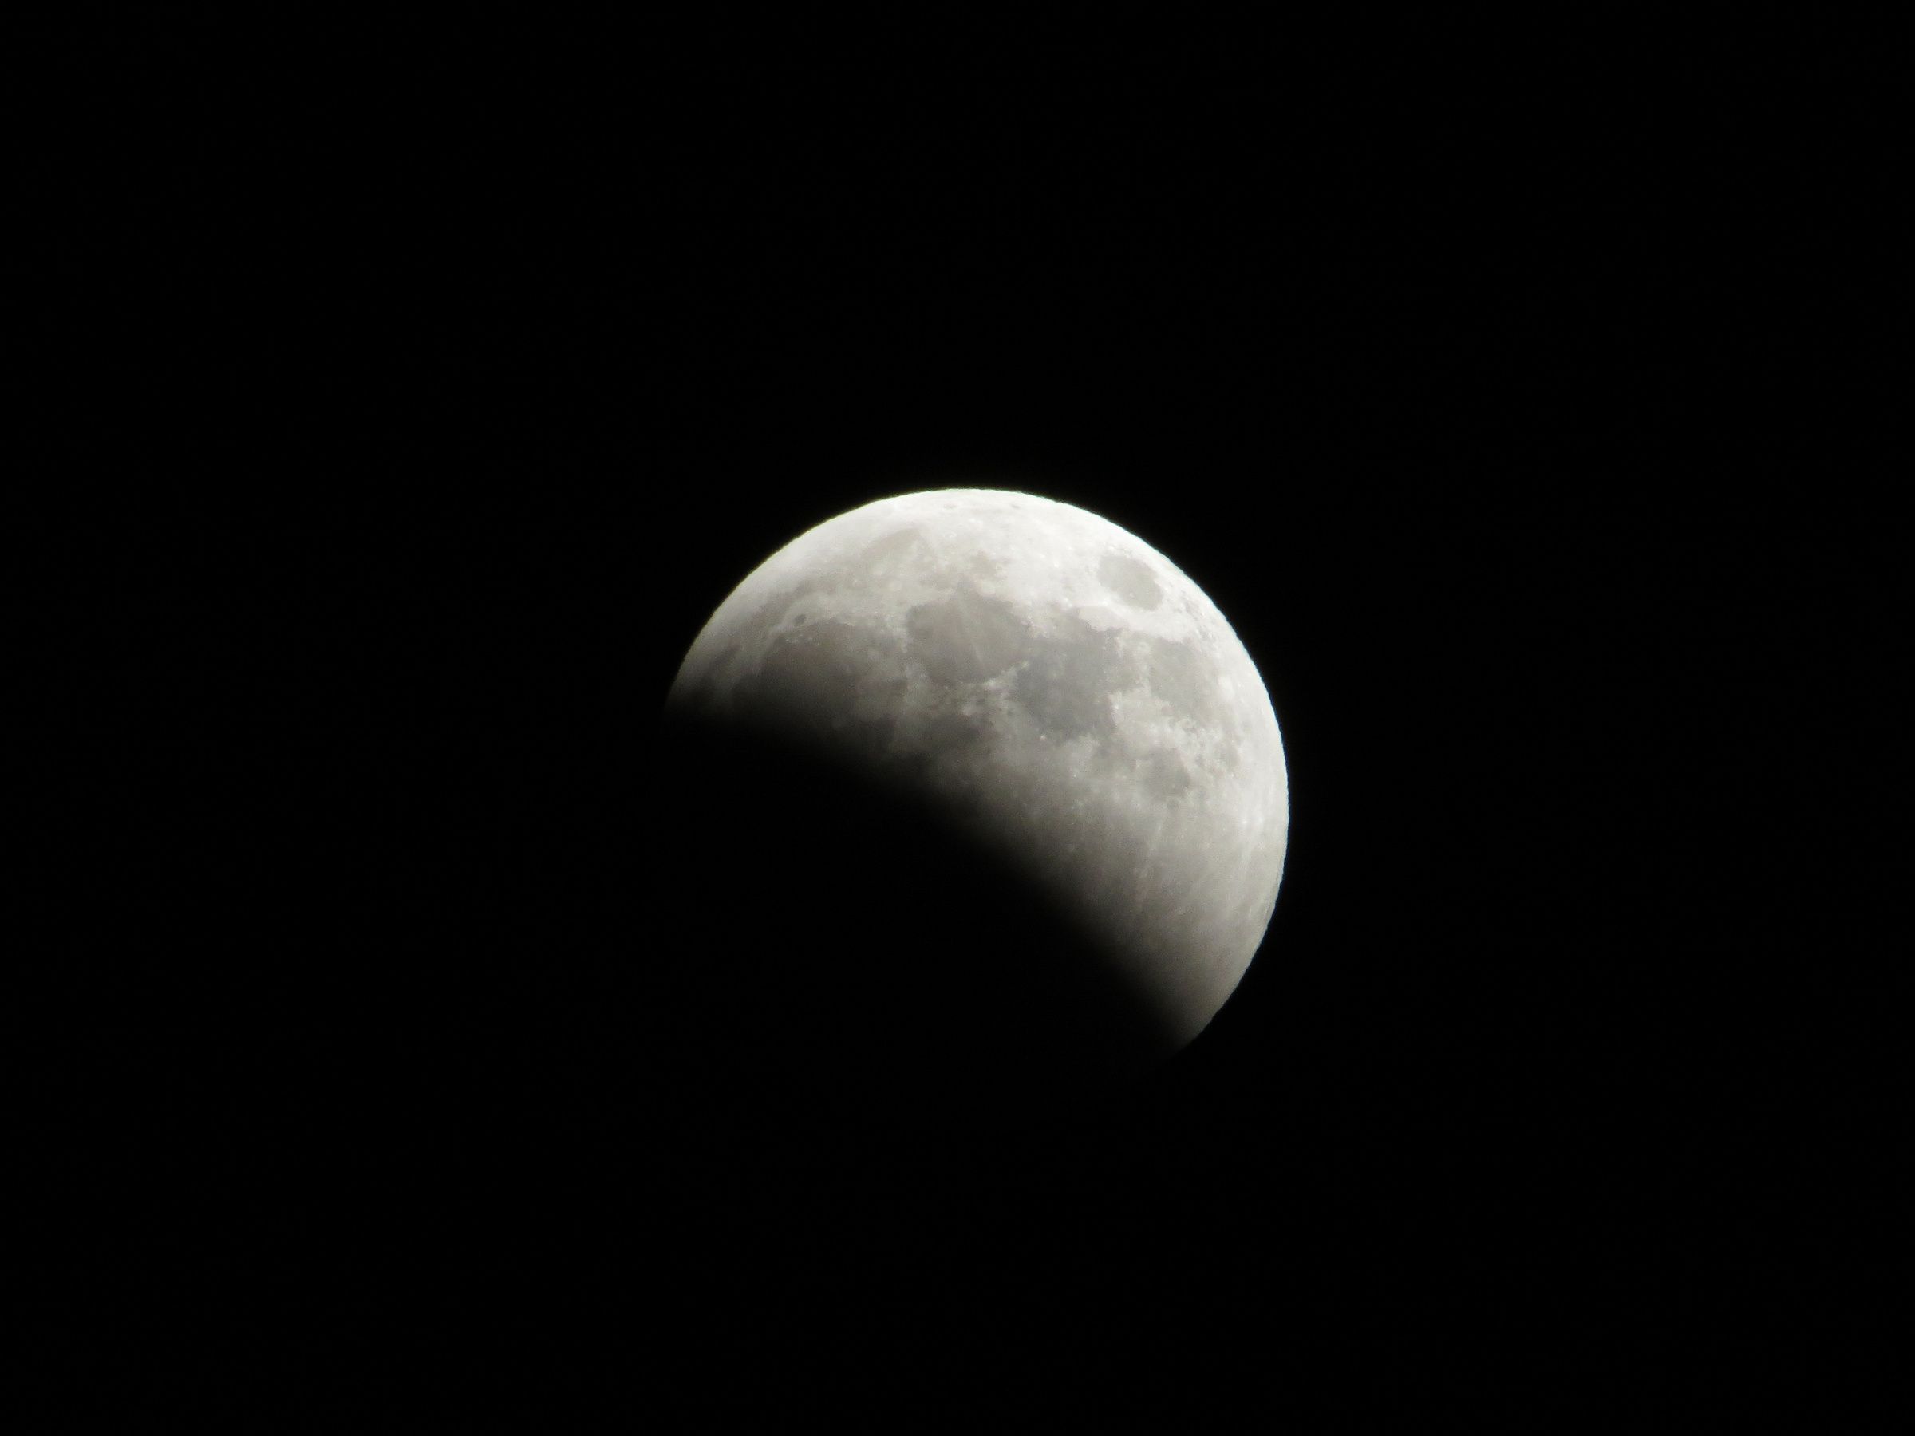
💻 Interactive Web Interface for Rapid Triage
Streamlined Workflow
upload CSV → run model → instantly view metrics and identified HZ planet names
Dashboard Features
model overview, confusion matrix, thresholds, and PR metrics in a clean, responsive layout
Accessibility & Outputs
high-contrast design, keyboard navigation, print-ready summaries, and JSON export (results.json) for further analysis

Slide 7
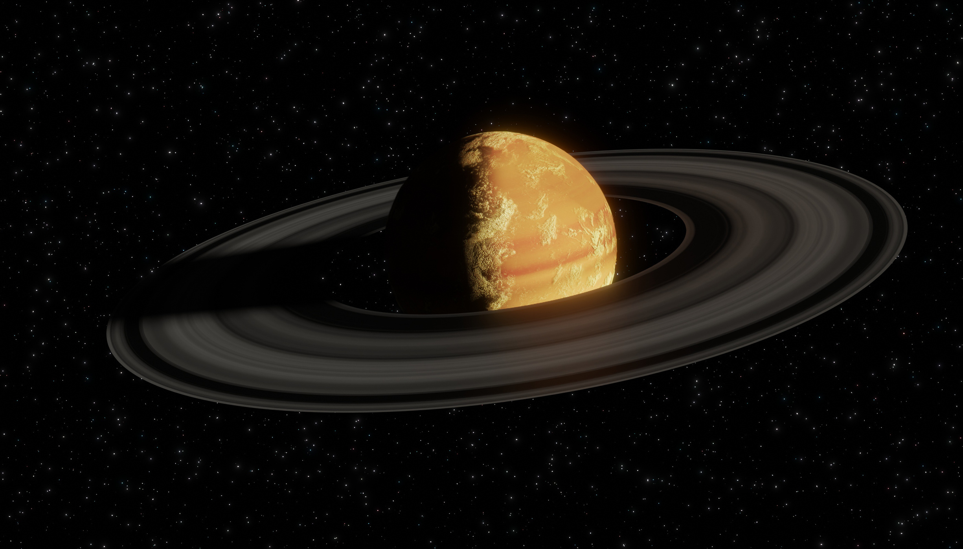
🚀 Toward Faster, Transparent Exoplanet Discovery
Impact
delivers faster, auditable triage centered on potentially habitable (HZ) worlds, improving research efficiency
Next Steps
add light-curve features, uncertainty estimates, active learning, ExoFOP integration, and HZ climatology layers
Open Science & Usability
transparent features, configurable thresholds, human-in-the-loop review, and open-source code with full configs and docs

